Slide 1
Chapter 21: Reinforcement Learning
These slides are adopted from Berkeley course materials, reinforcement learning Stanford course materials, UBC Intelligent Systems materials, Reinforcement Learning Sutton and Barto book, and Russell and Norvig textbook.

Slide 2
Recall-Markov decision process (MDP)
A Markov decision process (MDP) is defined by:
A set of states s ∈ S
A set of actions (per state) A
A transition model P(s’|a,s)
A reward function R(s,a,s’) or R(s)
Still looking for a policy π(s)
An optimal policy is a policy that maximizes the expected total reward.

Slide 3
Reinforcement Learning
The task of reinforcement learning is to use observed rewards to learn an optimal (or nearly optimal) policy for the environment.
Whereas in Chapter 17 the agent has a complete model of the environment (Transition model and reward function).
In this chapter, we still assume a Markov decision process, however the agent does not know both of the transition model P(s’| s, a), which specifies the probability of reaching state s from state s after doing action a; nor does it know the reward function R(s), which specifies the reward for each state.
In other words, the agent does not know which states are good or what the actions do.
Must actually try actions and states out to learn.

Slide 4
Reinforcement Learning
Agent
State: s
Reward: r
Actions: a
Environment
Basic idea:
Receive feedback in the form of rewards
Agent’s utility is defined by the reward function
Must (learn to) act so as to maximize expected rewards
All learning is based on observed samples of outcomes!

Slide 5
Reinforcement Learning
In many complex domains, reinforcement learning is the only feasible way to train program to perform at high levels.
For example, in game playing, it is very hard for a human to provide accurate and consistent evaluations of large numbers of positions, which would be needed to train an evaluation function directly from examples.
Instead, the program can be told when it has won or lost, and it can use this information to learn an evaluation function that gives reasonably accurate estimates of the probability of winning from any given position.

Slide 6
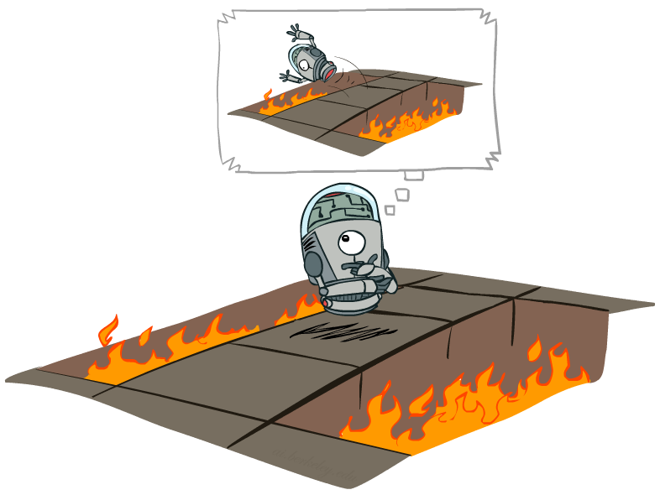

Offline (MDPs) vs. Online (RL)
Offline Solution
Online Learning

Slide 7
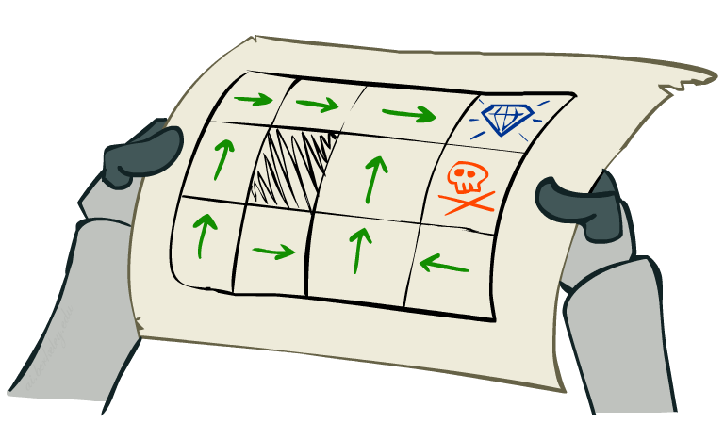
Passive Reinforcement Learning
We assume a fully observable environment.
In passive learning, the agent’s policy π is fixed:
In state s, it always executes the action π(s).
Its goal is simply to learn how good the policy is that is, to
learn the utility function U^{π}(s).
The passive learning task is similar to the policy evaluation task in the policy iteration algorithm (Chapter 17).
However, the passive learning agent does not know the transition model P(s’| s, a) nor does it know the reward function R(s).

Slide 8
Passive Reinforcement Learning
Simplified task: policy evaluation
Input: a fixed policy π(s)
You don’t know the transition model P(s’|s,a)
You don’t know the rewards R(s,a,s’)
Goal: learn the utility values for the states.
In this case:
No choice about what actions to take.
Just execute the policy and learn from experience how good it is.
This is NOT offline planning! You actually take actions in the world.

Slide 9
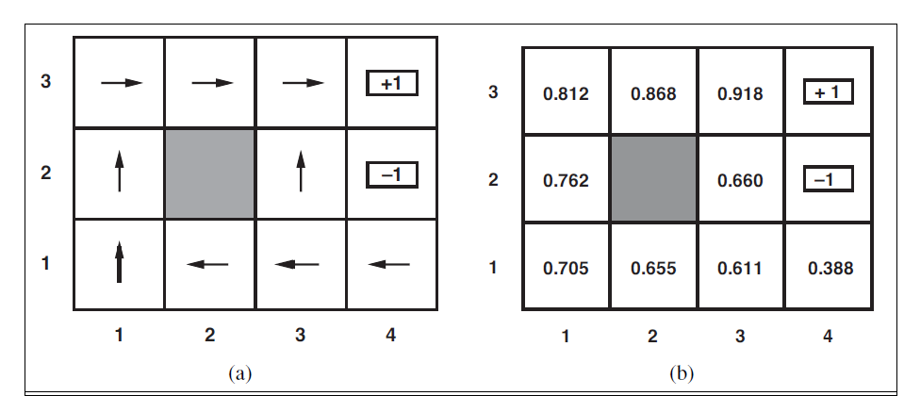
Passive Reinforcement Learning
(a) A policy π for the 4×3 world; this policy R(s)= − 0.04 in the nonterminal states and γ=1 (No discounting)
(b) The utilities of
the states in the 4×3 world, given policy π.

Slide 10
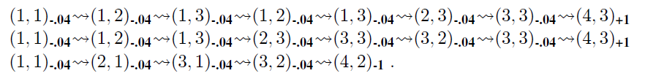
Passive Reinforcement Learning- Example
The agent executes a set of trials in the environment using its policy π.
In each trial, the agent starts in state (1,1) and experiences a sequence of state transitions until it reaches one of the terminal states, (4,2) or (4,3).
The agent’s percepts supply both the current state and the reward received in that state.
Typical trials might look like this:

Slide 11

Passive Reinforcement Learning
Given these trials, the agent learn the expected utility U^{π}(s) associated with each nonterminal states.
where R(s) is the reward for a state, S_{t} (a random variable) is the state reached at time t when
executing policy π, and S₀ =s.
The utility of a state is the expected total reward from that state onward.

Slide 12
Direct Utility Estimation
Goal: Compute utilities for each state under π
Idea: Average together observed sample values
Act according to π
Every time you visit a state, write down what the sum of discounted rewards turned out to be
Average those samples

Slide 13
Direct Utility Estimation
Each trial provides a sample of the expected total reward for each state visited.
For state (1,1), the first trial provides a sample total reward of:
1-0.04*7=1-0.28=0.72
Similarly, two samples for the state(1,2):
1-0.04*6=1-0.24=0.76.
1-0.04*4=1-0.16=0.84.

Slide 14
Example: Direct Utility Estimation
Input Policy π
Observed Episodes (Training)
Output Values
Episode 1
Episode 2
 | A
B | C | D
 | E
 | A
B | C | D
 | E
B, east, C, -1
C, east, D, -1
D, exit, x, +10
B, east, C, -1
C, east, D, -1
D, exit, x, +10
-10
+8
+4
+10
Episode 3
Episode 4
-2
E, north, C, -1
C, east, D, -1
D, exit, x, +10
E, north, C, -1
C, east, A, -1
A, exit, x, -10
If B and E both go to C under this policy, how can their values be different?
Assume: γ = 1
Terminal states are: A and D

Slide 15
Direct Utility Estimation
Thus, at the end of each sequence, the algorithm calculates the observed reward-to-go for each state and updates the estimated utility for that state accordingly, just by keeping a running average for each state.
In the limit of infinitely many trials, the sample average will converge to the true expectation of utility.
It doesn’t require any prior knowledge of the transition model or the reward function.

Slide 16
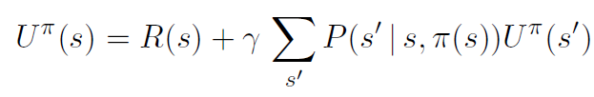
Problems with Direct Utility Estimation
The utilities of states are not independent!
The utility values obey the Bellman equations for a fixed policy:
By ignoring the connections between states, direct utility estimation misses opportunities for learning.
Thus, direct utility estimation often converges very slowly.
Output Values
 | A
B | C | D
 | E
-10
+8
+4
+10
-2
If B and E both go to C under this policy, how can their values be different?

Slide 17
Model-Based Learning
Model-Based Idea:
Learn an approximate model based on experiences
Solve for utilities as if the learned model were correct
Step 1: Learn empirical MDP model
Count outcomes s’ for each s, a
Normalize to give an estimate of P(s’|s,a)
Discover each R(s) when we experience (s, a, s’)
Step 2: Solve the learned MDP
For example, use the policy evaluation algorithm.

Slide 18


Example: Model-Based Learning
Input Policy π
Observed Episodes (Training)
Learned Model
Episode 1
Episode 2
$\hat{\text{P}} (s^{′}|s,a)$a
P(C|B, east) = 1.00
P(D|C, east) = 0.75
P(A|C, east) = 0.25
…
R(s,a,s’).
R(B, east, C) = -1
R(C, east, D) = -1
R(D, exit, x) = +10
…
 | A
B | C | D
 | E
B, east, C, -1
C, east, D, -1
D, exit, x, +10
B, east, C, -1
C, east, D, -1
D, exit, x, +10
Episode 3
Episode 4
E, north, C, -1
C, east, D, -1
D, exit, x, +10
E, north, C, -1
C, east, A, -1
A, exit, x, -10
Assume: γ = 1

Slide 19
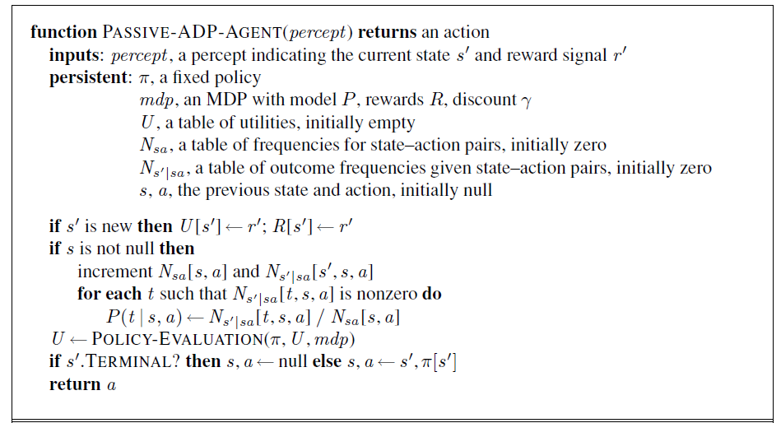
Adaptive Dynamic Programming (ADP)
An adaptive dynamic programming (or ADP) agent is an example of model-based passive reinforcement learning.
The ADP agent is limited only by its ability to learn the transition model.

Slide 20
Average Through Time
Suppose we have a sequence of values (your sample data): v₁, v₂, .., v_{k}
And want a running approximation of their expected value e.g., given sequence of grades, estimate expected value of next grade
A reasonable estimate is the average of the first k values:
Notes:
One of the main elements of Q-learning

Slide 21
Average Through Time
New value
New Estimate
Previous Estimate

Slide 22
Temporal Difference Learning
Temporal difference uses the observed transitions to adjust the utilities of the observed states so that they agree with the Bellman constraint equations.
Update U(s) each time we experience a transition (s, a, s’, r)
Likely outcomes s’ will contribute updates more often.
Policy is still fixed, still doing evaluation!

Slide 23
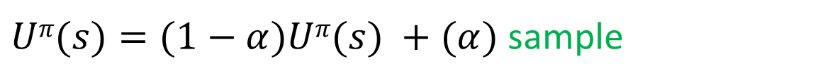
Temporal Difference Learning
Move utilities toward value of whatever successor occurs: running average
Using the running average equation:
Because this update rule uses the difference in utilities between successive states (the new utility value versus the previous estimate of it) , it is often called the temporal-difference.
Sample of U(s):
$$sample=R\left(s\right)+γUπ(s^{′})$$
$Uπ(s)=(1−α)Uπ(s) +(α)$ sample
$$Uπ\left(s\right)=Uπ\left(s\right)+α\left(R\left(s\right)+γUπ(s^{′}) −Uπ(s\right))$$

Slide 24
Example: Temporal Difference Learning
Observed Transitions
States
B, east, C, -2
C, east, D, -2
 | A
B | C | D
 | E
 | 0
0 | 0 | 8
 | 0
 | 0
-1 | 0 | 8
 | 0
 | 0
-1 | 3 | 8
 | 0
Assume: γ = 1, α = 1/2
$$Uπ(s)=Uπ(s)+α(sample−Uπ(s))$$

Slide 25
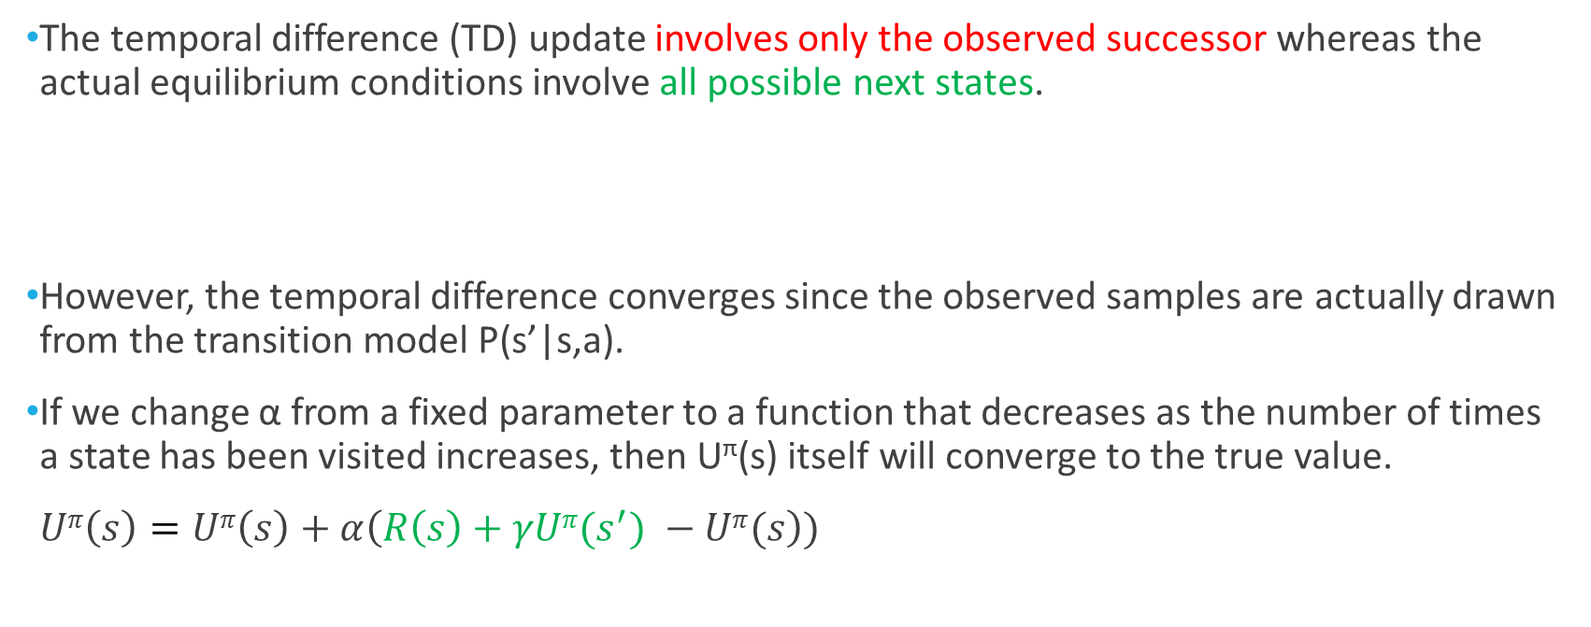
Temporal Difference Learning
The temporal difference (TD) update involves only the observed successor whereas the actual equilibrium conditions involve all possible next states.
However, the temporal difference converges since the observed samples are actually drawn from the transition model P(s’|s,a).
If we change α from a fixed parameter to a function that decreases as the number of times a state has been visited increases, then U^{π}(s) itself will converge to the true value.
$Uπ\left(s\right)=Uπ\left(s\right)+α\left(R\left(s\right)+γUπ(s^{′}) −Uπ(s\right))$

Slide 26
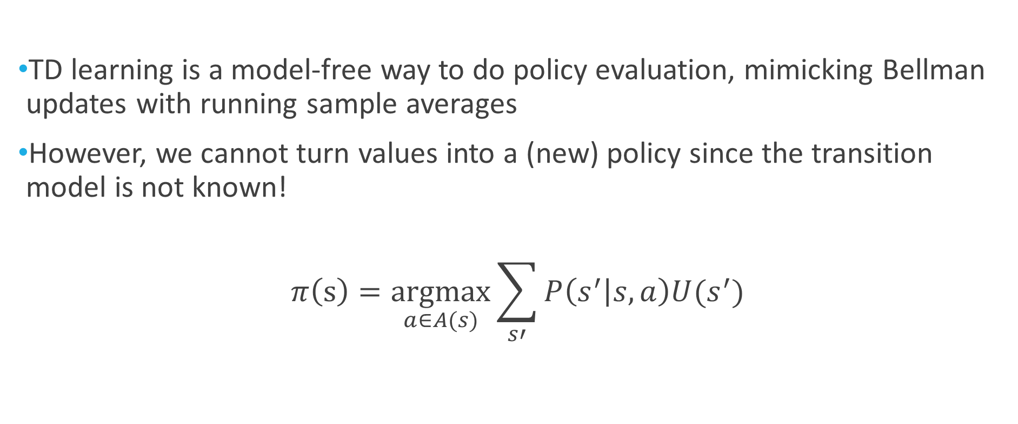
Problems with TD Learning
TD learning is a model-free way to do policy evaluation, mimicking Bellman updates with running sample averages
However, we cannot turn values into a (new) policy since the transition model is not known!
$$π\left(s\right)=\underset{a∈A(s)}{argmax}{\sum_{s′}{P\left(s^{′} | s,a\right)U(s^{′})}}$$

Slide 27
Active Reinforcement Learning
A passive learning agent has a fixed policy and applies it.
An active agent must decide what actions to take.
We will consider:
Q-learning
Sarsa
Active ADP

Slide 28
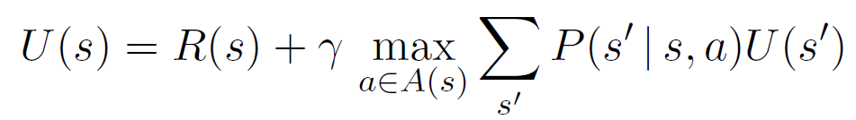
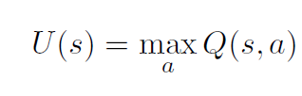
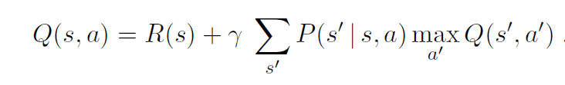
Q-Learning
Q-learning learns an action-utility representation instead of learning utilities.
Q(s, a) denotes the utility value of doing action a in state s.
Recall the Bellman equation:
Q-values are directly related to utility values as follows:

Slide 29

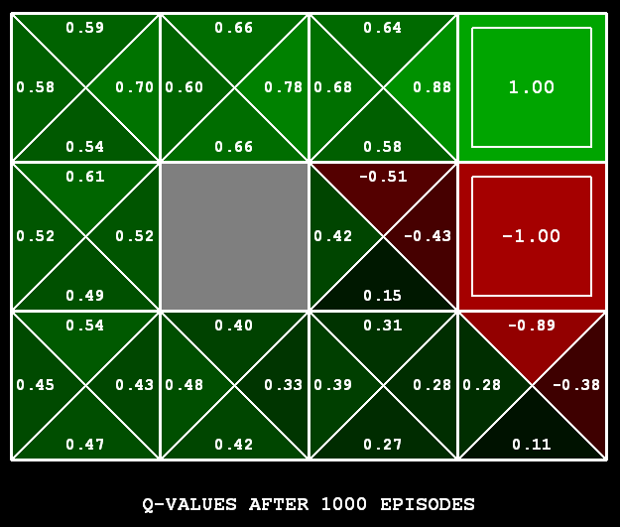
Q-Learning
Q-Learning: sample-based Q-value iteration
Learn Q(s,a) values as you go
Receive a sample (s,a,s’,r)
Consider your old estimate:
Consider your new sample estimate:
Incorporate the new estimate into a running average:
0D3)]

Slide 30
Q-Learning
A Temporal Difference agent that learns a Q-function does not need a transition model P(s’| s, a), neither for learning nor for action selection.
Thus, Q-learning is a model-free method.
Qlearning calculates Q values, then how the agent should act?

Slide 31
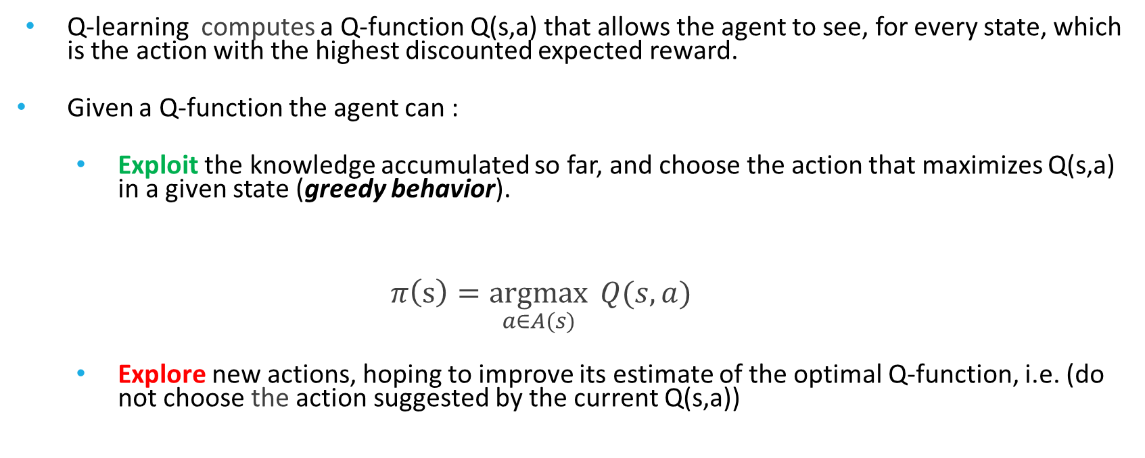
Exploration vs. Exploitation
Q-learning computes a Q-function Q(s,a) that allows the agent to see, for every state, which is the action with the highest discounted expected reward.
Given a Q-function the agent can :
Exploit the knowledge accumulated so far, and choose the action that maximizes Q(s,a) in a given state (greedy behavior).
$$π\left(s\right)=\underset{a∈A(s)}{argmax}{ Q(s,a) }$$
Explore new actions, hoping to improve its estimate of the optimal Q-function, i.e. (do not choose the action suggested by the current Q(s,a))

Slide 32
Exploration vs. Exploitation
Actions not only provide rewards, but also they contribute to learning the true model by affecting the percepts that are received.
By improving the model, the agent will receive greater rewards on the long term.
There is a tradeoff between exploitation and exploration.
Exploration (Take actions that have not been tried much in a state to improve the agent’s learning model (Qvalues)).
Exploitation(Take actions whose estimate will yield high discounted expected reward).

Slide 33
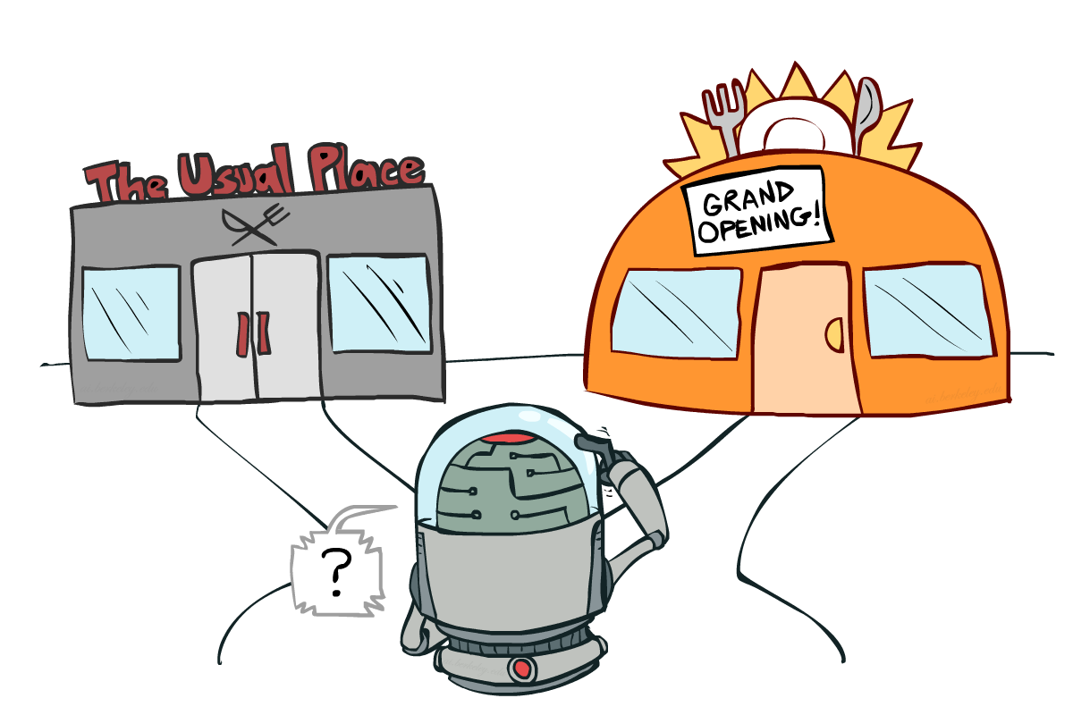
Exploration vs. Exploitation

Slide 34
Exploration
The learned model is not the same as the true environment; what is optimal in the learned model can therefore be suboptimal in the true environment.
Unfortunately, the agent does not know what the true environment is, so it cannot compute the optimal action for the true environment.
Thus, the agent needs to explore other actions!

Slide 35
Exploration vs. Exploitation
When to explore and when the exploit?
Never exploring may lead to being stuck in a suboptimal course of actions
Exploring too much is a waste of the knowledge accumulated via experience
Must find the right compromise!

Slide 36
Exploration Strategies
It is very hard to obtain an optimal exploration method. However, it is possible to come up with a reasonable scheme that will eventually lead to optimal behavior by the agent.
Technically, any such scheme needs to be greedy in the limit of infinite exploration (GLIE).
A GLIE scheme must do the following:
Must try each action in each state an unbounded number of times to avoid having a finite probability that an optimal action is missed because of an unusually bad series of outcomes.
Must eventually become greedy, so that the agent’s actions become optimal with respect to the learned (and hence the true) model.
We will look at two exploration strategies
ε-greedy
Exploration functions.

Slide 37
Epsilon (ε)-greedy
ε-greedy takes random actions as follows:
Every time step:
With (small) probability ε, act randomly.
With (large) probability 1-ε, choose the best action according to the learned Q values.
Problems with random actions?
You do eventually explore the space, but you do not exploit what you have learned!
One solution: lower ε over time, for example (ε=1/t)
Another solution: exploration functions
[
Notes:
you eventually learn the right thing but still thrash around

Slide 38


Exploration Functions
When to explore?
Explore areas whose badness is not (yet) established, eventually stop exploring.
Exploration function
Takes a value estimate u and a visit count N, and returns an optimistic utility
Note: this propagates the “bonus” back to states that lead to unknown states as well!
where R⁺ is an optimistic estimate of the best possible reward obtainable in any state and Ne is a fixed parameter.
This will have the effect of making the agent try each action–state pair at least Ne times.
Notes:
Optimism in the face of uncertainty

Slide 39
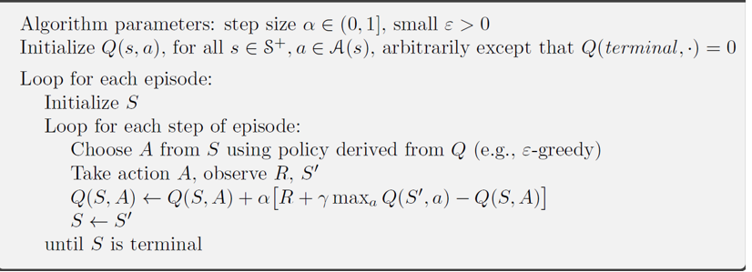
Q-learning

Slide 40
Q-Learning Properties
Q-learning converges to optimal policy -- even if you’re acting suboptimally!
This is called off-policy learning
You have to explore enough.
You have to eventually make the learning rate small enough.
… but not decrease it too quickly.
Basically, in the limit, it doesn’t matter how you select actions (!)
Notes:
Ofc you can figure out how well youre doing; but q learning tells you how well optimal actions are doing

Slide 41
State-Action-Reward-State-Action (Sarsa)
Sarsa is another temporal difference active reinforcement learning algorithm.
Sarsa Q update:
where a is the action actually taken in state s.
The rule is applied at the end of each (s, a, r, s’, a’), so it is named (SARSA).
SARSA waits until an action is actually taken and backs up the Q-value for that action.
Q-learning update:
Q-learning backs up the best Q-value from the state reached in the observed transition.
No max operator.
You evaluate Qvalue of the action you actually take!

Slide 42
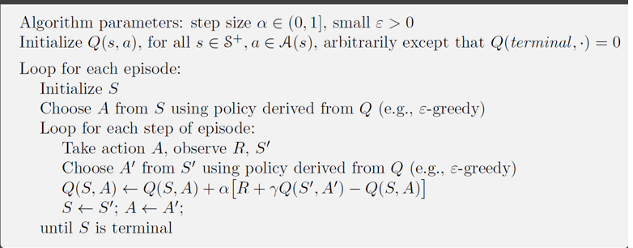
Sarsa

Slide 43
Qlearning vs. SARSA
Q-learning uses the best Q-value, it pays no attention to the actual policy being followed.
Q learning is an off-policy learning algorithm.
However, SARSA is an on-policy algorithm.
Q-learning is more flexible than SARSA, as a Q-learning agent can learn how to behave well
even when guided by a random or adversarial exploration policy.
On the other hand, SARSA is more realistic.
For a greedy agent that always takes the action with best Q-value, the two algorithms
are identical, however, when exploration is happening, they differ significantly.

Slide 44
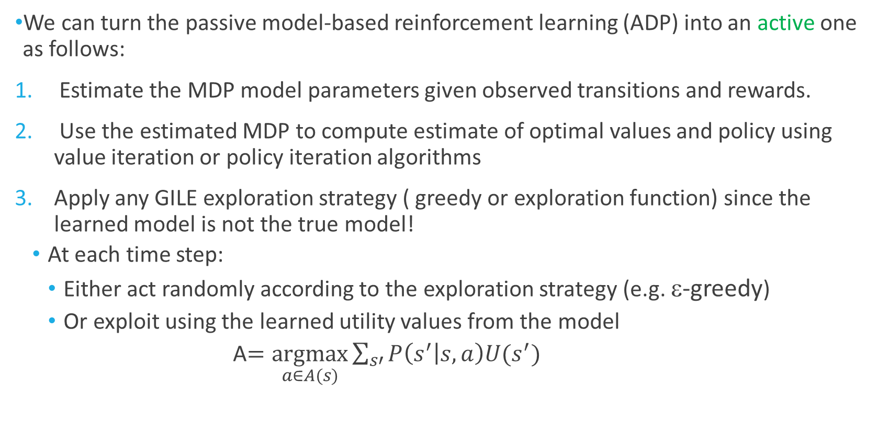
Active Model-based Reinforcement learning
We can turn the passive model-based reinforcement learning (ADP) into an active one as follows:
Estimate the MDP model parameters given observed transitions and rewards.
Use the estimated MDP to compute estimate of optimal values and policy using value iteration or policy iteration algorithms
Apply any GILE exploration strategy ( greedy or exploration function) since the learned model is not the true model!
At each time step:
Either act randomly according to the exploration strategy (e.g. ε-greedy)
Or exploit using the learned utility values from the model
A$=\underset{a∈A(s)}{argmax}{\sum_{s′}{P\left(s^{′} | s,a\right)U(s^{′})}}$

Slide 45
Model-based versus Model free Reinforcement Learning
Is it better to learn a model and a utility function or an action value function with no model?
This is still an open-question
Model-based approaches require less data to learn well, but they can be computationally more expensive.
Q-learning takes longer time to converge because it does not enforce consistency among Q-values via the model, but they are less computationally expensive.

Slide 46
Generalizing Across States
Basic Q-Learning keeps a table of all q-values for all states/states-actions pairs.
In realistic situations, we cannot possibly learn about every single state!
Too many states to visit them all in training, for Backgammon and chess, the state space if of order
10²⁰ and 10⁴⁰.
Too many states to hold the q-tables in memory
Instead, we want to generalize:
Learn about some small number of training states from experience
Generalize that experience to new, similar situations.
This is a fundamental idea in machine learning!

Slide 47
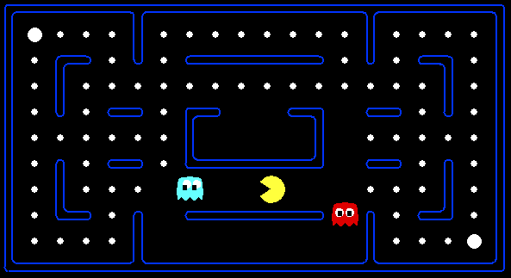



Example: Pacman
Let’s say we discover through experience that this state is bad:
In naïve q-learning, we know nothing about this state:
Or even this one!
Only one dot has changed!
Notes:
Want more compact representation that generalizes across state or
states and actions
Emma

Slide 48
Feature-Based Representations
Solution: describe a state using a vector of features (properties)
Features are functions from states to real numbers (often 0/1) that capture important properties of the state
Example features:
Distance to closest ghost
Distance to closest dot
Number of ghosts
1 / (dist to dot)²
Is Pacman in a tunnel? (0/1)
…… etc.
Is it the exact state on this slide?
Can also describe a q-state (s, a) with features (e.g. action moves closer to food)

Slide 49
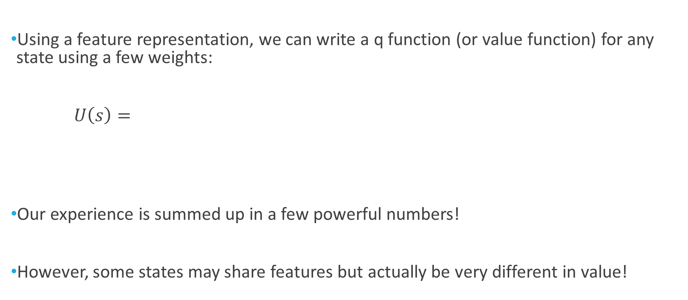
Linear Value Functions
Using a feature representation, we can write a q function (or value function) for any state using a few weights:
$U\left(s\right)=$
Our experience is summed up in a few powerful numbers!
However, some states may share features but actually be very different in value!

Slide 50
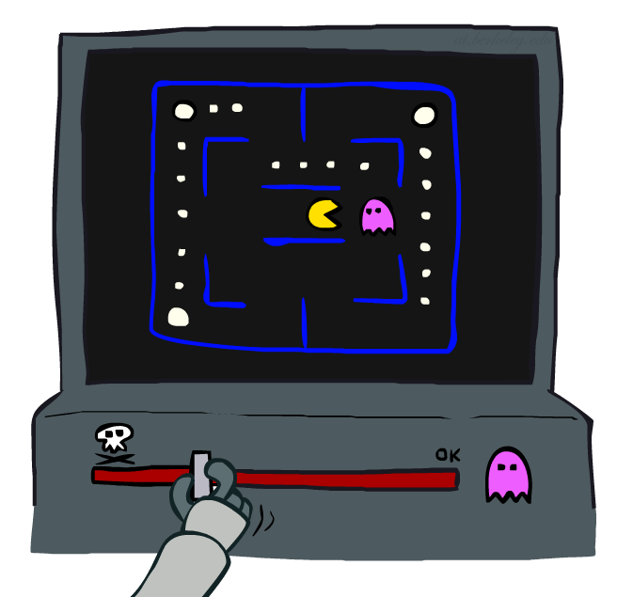
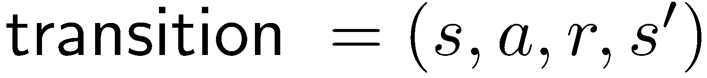
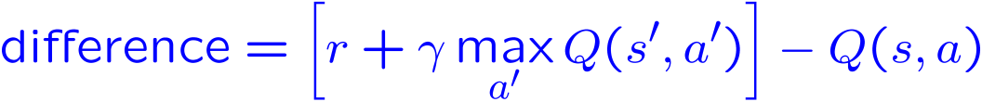
Approximate Q-Learning
Q-learning with linear Q-functions:
Exact Q’s
Approximate Q’s

Slide 51
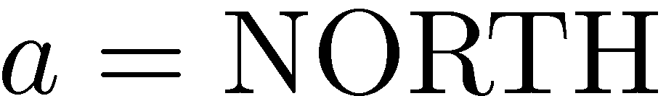
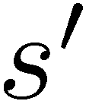

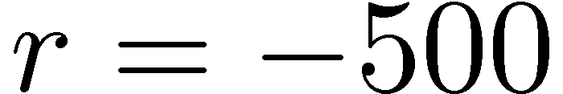


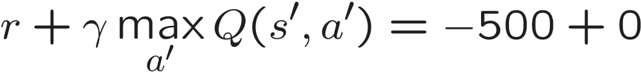
Example: Q-Pacman
Notes:
now when you run into ghosts you can figure out ghosts are bad; dots are good.
Alpha=0.004

Slide 52
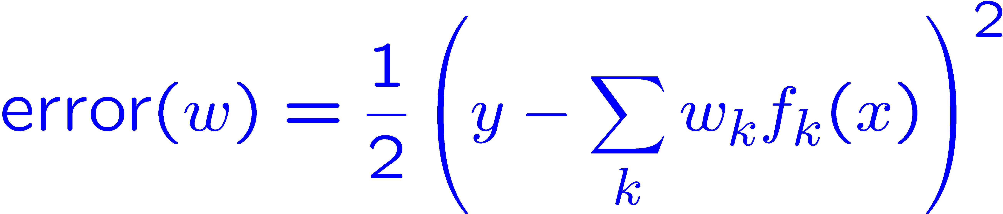
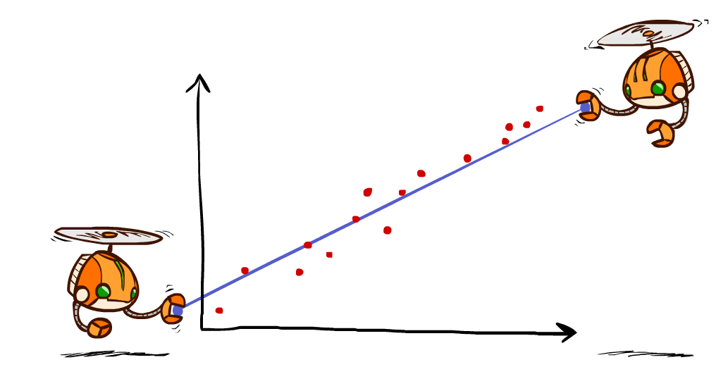
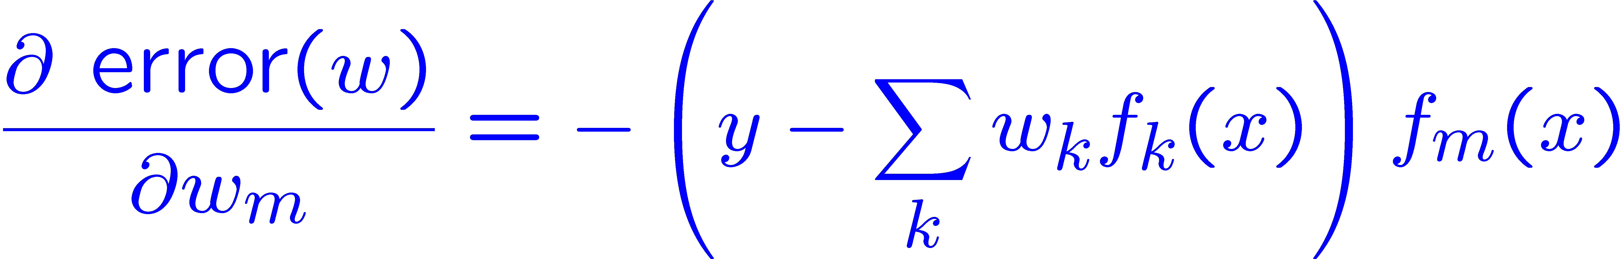
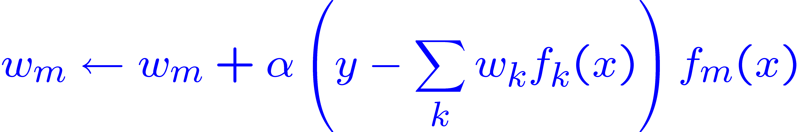
Minimizing Least Squares Error
Imagine we had only one point x, with features f(x), target value y, and weights w:
Approximate q update explained:
“target”
“prediction”

Slide 53
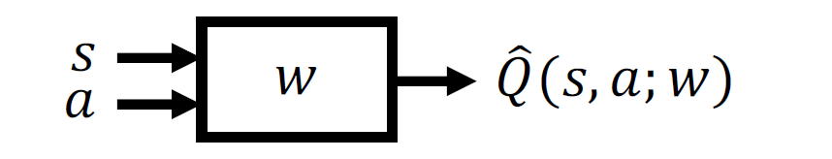
Approximate Qlearning
There are many possible function approximators, the most popular ones are:
Linear combinations of features
Neural networks
The representation is viewed as approximate because it might not be the case that the true utility function or Q-function can be represented in the chosen form.

Slide 54
Function Approximation
Advantages:
Function approximation makes it practical to represent utility functions for very large state spaces.
Function approximation allows the learning agent to generalize from states it has visited to states it has not visited.
Disadvantage:
There could fail to be any function in the chosen hypothesis space (function representation) that approximates the true utility function sufficiently well.

Slide 55

Policy Search
Policy search considers parameterized representations of the policy π that have far fewer parameters θ than there are states in the state space.
However, the policy is a discontinuous function of the parameters when the actions are discrete.
Thus, gradient-based search would be hard to be applied.
Consequently, policy search methods often use a stochastic policy representation π_{θ}(s, a), which specifies the probability of selecting action a in state s.

Slide 56
Policy Search
The goal is to find a policy that maximizes the policy value ρ(θ) . (optimization problem)
The policy value ρ(θ) is defined as the expected reward-to-go (utility) when πθ is executed.
This optimization problem can be solved using:
Gradient based methods if ρ(θ) is differentiable.
Local Search methods such as: hill climbing

Slide 57

Policy Search
One popular representation for the policy is the softmax function.
The softmax-based policy becomes nearly deterministic if one action is much better than the others.
The softmax function gives a differentiable function of θ; hence, the value of the policy ρ(θ) is a differentiable function of θ.

Slide 58
Applications of Reinforcement Learning
Games
Robotics
Self-driving cars

Slide 59
Summary
Reinforcement Learning
Passive (Direct utility estimation, ADP, TD) vs. Active reinforcement learning (Active ADP, Qlearning, Sarsa)
Model based (ADP) vs. Model free methods (TD, Qlearning, Sarsa)
Exploration vs. Exploitation
On-Policy (Sarsa) versus Off-Policy (Q-learning) learning.
Function approximation
Policy Search

